Slide 1
UNIT 1
BASICS OF COMPUTERS AND INTRODUCTION TO OPERATING SYSTEMS
Anubhav Patrick, CSE Dept., KIET Ghaziabad

Slide 2
Computer
A computer is an electronic device that takes some raw (unprocessed) data, processes it and generates some meaningful information
Analogue Vs. Digital Vs. Hybrid
Analogue Computers- that works on analogue signals
Digital Computers- that works on digital signals
Hybrid Computers- a combination of analogue and digital computers
Data
Process
Information

Slide 3

Applications of computers

Slide 4
Basic operations of a computer
Accepting data or instructions (INPUT)
Storing data
Processing data
Displaying data (OUTPUT)
Controlling and coordinating above tasks

Slide 5
Characteristics of Computers
Speed
Accuracy
Diligence
Versatility
Storage Capacity
No IQ

Slide 6
Generations of Computers
The word ‘Generation’, when applied to computing, refers to the different advancements in computer technology.
The focus of every new generation has been on miniaturization, speed, power, and efficient computer memory.

Slide 7
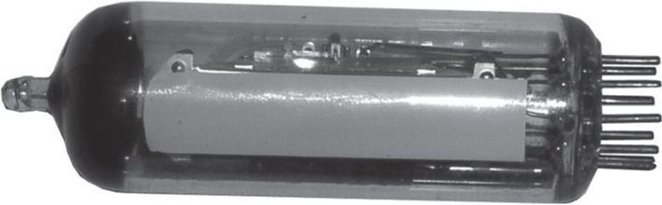
First Generation (1940-1956): Vacuum Tubes
Advantage
Fastest calculating devices of their time
Disadvantages
Generated a lot of heat
Consumed a lot of electricity
Bulky in size
Prone to frequent hardware failure
Required constant maintenance because of the low mean time between failures
Limited commercial use
Very expensive
Notes:
Example- Mark 1, ENIAC, EDVAC- Electronic Discrete Variable Automatic Computer

Slide 8
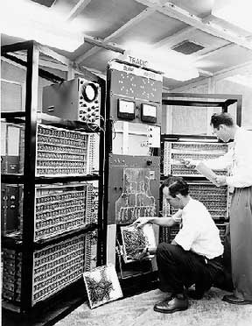
First Generation (1940-1956): Vacuum Tubes

Slide 9
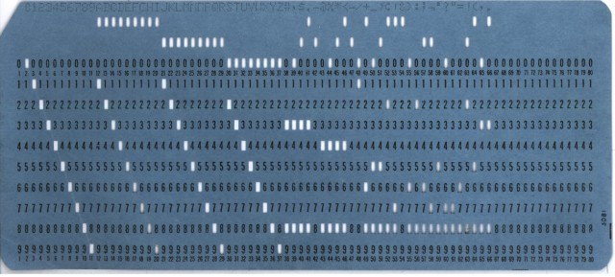
First Generation (1940-1956): Vacuum Tubes
Used Punched Cards for input and output

Slide 10
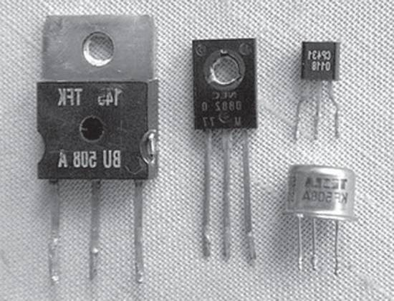
Second Generation (1956-1963): Transistors
Advantages
Consumed less electricity
Generated less heat
Faster, cheaper, smaller, and more reliable
Could be programmed using assembly and high-level languages
Had faster primary memory and a larger secondary memory
Disadvantage
They were still big, bulky and unreliable
Transistors had to be assembled manually, which made commercial production of computers difficult and expensive

Slide 11
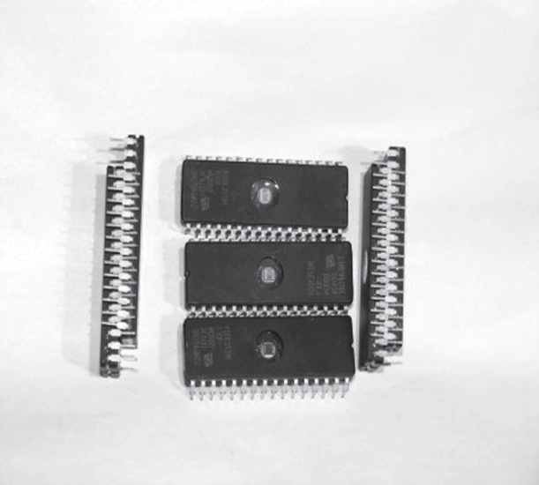
Third Generation (1964-1971): Integrated Circuits
Advantages
Faster and could perform one million transactions per second
Smaller, cheaper, and more reliable
Faster and larger primary memory and secondary storage
Widely used for scientific as well as business applications
Supported time sharing operating systems
Disadvantages
Difficult to maintain
Got heated very quickly

Slide 12
Fourth Generation (1971-Present): Microprocessors
Advantages
Smaller, cheaper, faster, and more reliable
Consumed less electricity and generated less heat
Faster and larger primary memory and secondary storage
Could be used as general-purpose computers
GUIs enabled people to learn to work with computers very easily
Lead to widespread use of computers in offices and at homes
Networks allowed sharing of resources
Disadvantage
Not intelligent systems

Slide 13
Fifth Generation (Present and Beyond): ULSI and Artificial Intelligence
Gaming: Computers are programmed to play games such as chess and checkers. More recent examples of such gaming systems include PlayStation by Sony.
Expert systems: Computers are programmed to take decisions in real-world situations.
Natural languages: Computers are programmed to understand and respond to natural human languages.

Slide 14
Fifth Generation (Present and Beyond): Artificial Intelligence
Neural networks: Systems are programmed to simulate intelligence by reproducing the physical connections that take place in animal brains.
Robotics: Computers are programmed to look, listen, and react to other sensory stimuli.

Slide 15
Hardware
Computer hardware is the collection of physical elements that constitutes a computer system.
Hardware consists of all the components of a computer that can be touched
For example- monitor, mouse, keyboard, computer data storage, hard drive disk (HDD), printer etc.

Slide 16
Software
A software is a set of instructions to the computer system to perform a particular task.
Software is a collection of one or more computer programs
Unlike hardware, a software can not be touched and is stored inside computer’s memory
e.g., web browser, games, word processor, operating system etc

Slide 17
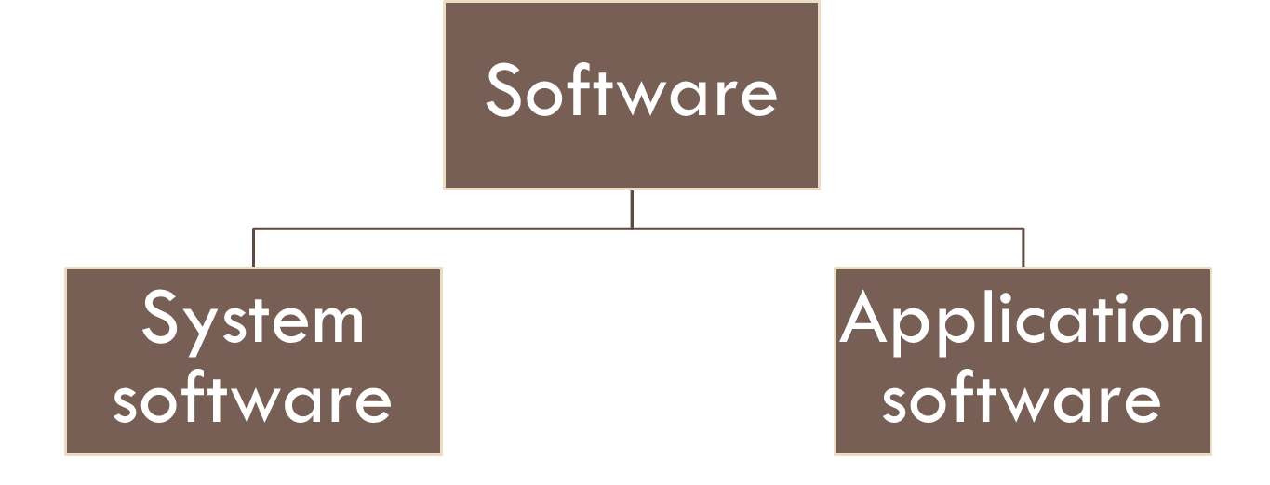
Types of software
Application Software is a set of programs to carry out operations for a specific application. e.g., payroll management, marks monitoring etc.
System software a set of one or more programs designed to control the operation of computer system. e.g.,operating system, antivirus etc

Slide 18
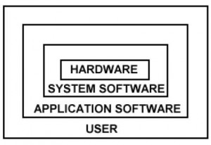
Relation between hardware and software

Slide 19
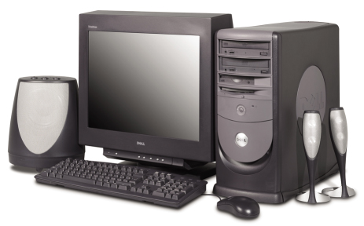
Types of Computers
Supercomputers
Mainframe computers
Minicomputers
Microcomputers
1-<number>
Notes:
There are four types of computers
Supercomputers
Mainframe computers
Minicomputers
Microcomputers
desktop
laptop or notebook
tablet PC
Handheld computers
Palm computers
Persona digital assistants

Slide 20
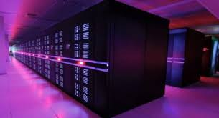
Supercomputers
Most powerful type of computers
Very expensive (millions of dollars)
Specific purpose
Used by large organizations
  Tracking space
  Tracking weather
  Nuclear research
  Genetics and complex medical research
  Complex engine modeling and design etc
E.g., Tianhe 2 and Titan supercomputers
Tianhe 2
Notes:
Most powerful supercomputers in 2016 Sunway TaihuLight
Above is an example of a Cray supercomputer, which, unlike the illustration, is always in an air conditioned box
This is required because of the heat generated during processing
A major reason for its processing speed is shorted connection wires throughout the interior
Of course, shorter wires means faster byte transfer times
Supercomputers are the most powerful type of computer
NASA uses supercomputers to track and control space exploration

Slide 21
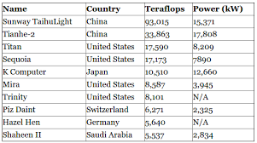
Top 10 Supercomputers In World
Notes:
1 Teraflops = 10^12 flops

Slide 22
Mainframe Computers
Not as powerful as supercomputers
Capable of great processing speeds and data storage
Occupies specially wired, air-conditioned rooms
Used by
  Banks
  Airlines
  Hospitals
  Insurance Agencies
  Railways
  Share Trading Agencies
Notes:
Mainframes occupy specially wired, air-conditioned rooms
Not as powerful as supercomputers
Insurance, financial and equity industries, as well as governments all process large amounts of information on mainframes
Mainframe Manufacturers- IBM, HP, Fujitsu etc.

Slide 23
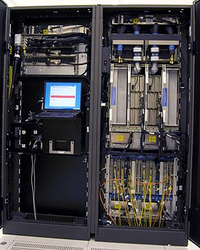
Inside an IBM System z9 mainframe

Slide 24
Minicomputers
Also known as midrange computers
Smaller, slower and cheaper than mainframes
Medium-size companies
Used by departments of large companies for inventory management, operation control etc.
1-<number>
Notes:
These are refrigerator sized machines
Production departments use minicomputers to monitor certain manufacturing processes and assembly line operation s
Problem is most current desktops have capacity of many minicomputers.

Slide 25
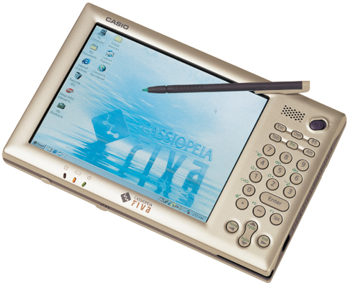
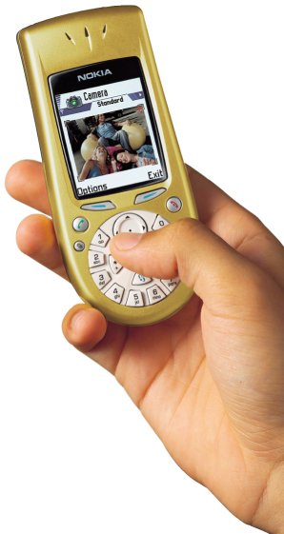
Microcomputers
Least powerful
Widely used
Very cheap
Four types
  Desktop
  Notebook or laptop
  Tablets
  Handheld – smartphones, PDAs
1-<number>
Notes:
Lease powerful computers, but most widely used
Fastest growing computer
Have students begin discussing the microcomputer and wireless connectivity

Slide 26
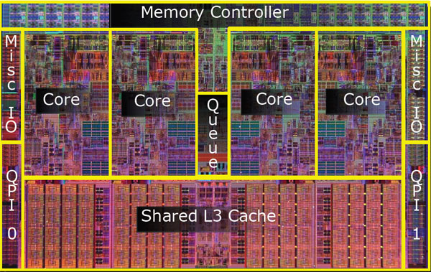
A Typical Modern Day Computer- Processor

Slide 27

Functional components of a computer
[Very Imp]

Slide 28
Functional components of a computer
Input Unit
Storage Unit
Output Unit
Control Unit
Central Processing
Unit
Arithmetic Logic Unit

Slide 29
Functional components of a computer
Input Unit: This unit is used for entering data and programs into the computer system by the user for processing.
Storage Unit: The storage unit is used for storing data and instructions before and after processing.
Output Unit: The output unit is used for storing the result as output produced by the computer after processing.
Processing: The task of performing operations like arithmetic and logical operations is called processing.
  CPU – Central Processing Unit

Slide 30
Functional components of a computer
Central Processing Unit: CPU takes data and instructions from the storage unit and makes all sorts of calculations based on the instructions given and the type of data provided
CPU consists of
    Arithmetic Logic Unit (ALU)
    Control Unit (CU)
Arithmetic Logic Unit: All calculations and comparisons, based on the instructions provided, are carried out within the ALU
It performs arithmetic functions like addition, subtraction, multiplication, division and also logical operations like greater than, less than and equal to etc.

Slide 31
Functional components of a computer
Control Unit: Controlling of all operations like input, processing and output are performed by control unit. It takes care of step by step processing of all operations in side the computer.

Slide 32
Operating Systems

Slide 33
General Definition
An OS is a program which acts as an intermediary/interface between computer system users and the computer hardware.
It provides a user-friendly environment in which a user may easily develop and execute programs.
Otherwise, hardware knowledge would be mandatory for computer programming.
So, it can be said that an OS hides the complexity of hardware from uninterested users.

Slide 34
General Definition
In general, a computer system has some resources which may be utilized to solve a problem. They are
  Memory
  Processor(s)
  I/O
  File System
  Network (LANs and WANs)
  etc.

Slide 35
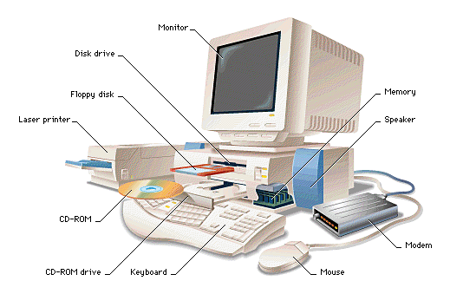
General Definition
Mainboard

Slide 36
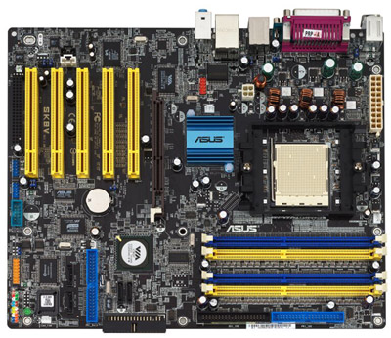
General Definition

Slide 37
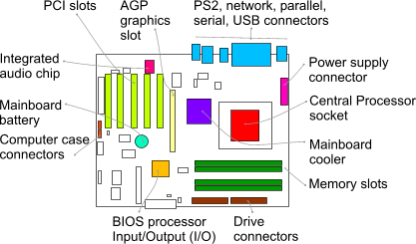
General Definition
mainboard

Slide 38
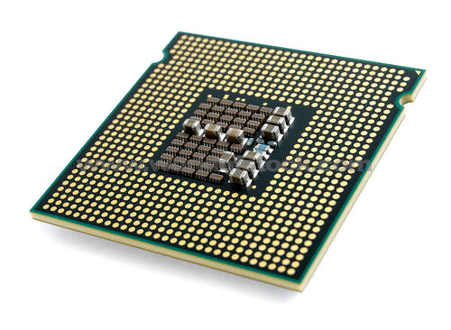


General Definition
processor

Slide 39
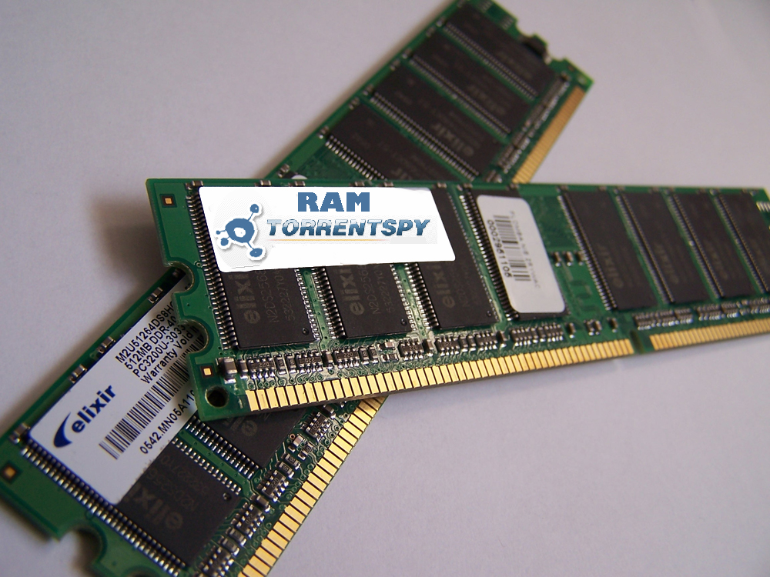
General Definition
RAM

Slide 40
General Definition
The OS manages these resources and allocates them to specific programs and users.
With the management of the OS, a programmer is rid of difficult hardware considerations.
An OS provides services for [VERY IMP!!!]
  User Interface
  Process Management
  Memory Management (RAM)
  File Management (Hard Disk)
  Resource Management (Processor, Input-Output devices)
  Concurrency Control
  Security Management

Slide 41
General Definition
Another aspect for the usage of OS is that; it is used as a predefined library for hardware-software interaction.
This is why, system programs apply to the installed OS since they cannot reach hardware directly.
Application Programs
System Programs
Operating System
Machine Language
HARDWARE

Slide 42
General Definition
Since we have an already written library, namely the OS, to add two numbers we simply write the following line to our program:
c = a + b ;

Slide 43
General Definition
in a system where there is no OS installed, we should consider some hardware work as:
(Assuming an MC 6800 computer hardware)
  LDAA $80 → Loading the number at memory location 80
  LDAB $81 → Loading the number at memory location 81
  ADDB → Adding these two numbers
  STAA $55 → Storing the sum to memory location 55
As seen, we considered memory locations and used our hardware knowledge of the system.

Slide 44
General Definition
In an OS installed machine, since we have an intermediate layer, our programs obtain some hardware independence by not dealing with hardware.
For example, the above program segment would not work for an 8086 machine, where as the
“c = a + b ;”
syntax will be suitable for both.

Slide 45
Operating System Kernel
The kernel is the central module of an operating system (OS)
It is the part of the operating system that loads first, and it remains in main memory.
Typically, the kernel is responsible for memory management, process and task management, and disk management.
Every operating system has a kernel
E.g., Linux Operating System- Fress BSD kernel
  MS Windows- Windows NT Kernel, Windows CE Kernel

Slide 46
Operating System Types
Single User: One user can access one computer at a time e.g. DOS
Multi User: Many users can access the same computer at the same time and different time e.g. Windows, UNIX, LINUX
Multiprocessing: more than one processor is there e.g. UNIX, LINUX, and WINDOWS XP
Multitasking: It allows many software processes to run at the same time e.g. UNIX, LINUX, and WINDOWS

Slide 47
Operating System Types
Multithreading: It allows different parts of a software program to run concurrently e.g. LINUX, UNIX and WINDOWS XP.
Distributed: Is an operating system that manages a large number of independent, networked, communicating and physically separate computers e.g., AIX OS , IRIX OS etc.

Slide 48
Popular Operating Systems
MS DOS, MS Windows, Linux, Android

Slide 49
Microsoft (MS) DOS
Non-graphical command line operating system
Widely installed OS in PCs in 1980s
MS DOS originated in the form of 86-DOS by Seattle Corporation in 1980
IBM requested Microsoft to develop OS for IBM PC
Microsoft purchased and modified 86-DOS to meet IBM’s specifications
First version of MS DOS shipped in August1981
It was the underlying basic OS on which early versions of MS Windows ran

Slide 50
MS DOS
Easy to load and install with not much memory requirement and sophisticated computers to run on
Information about data and commands and programs should be known to the user
Single-user single-task operating system
Does not have built-in support for networking
Total 8 versions of MS DOS were released between 1981 to 2000
Notes:
Primarily designed by Microsoft for IBM PC

Slide 51
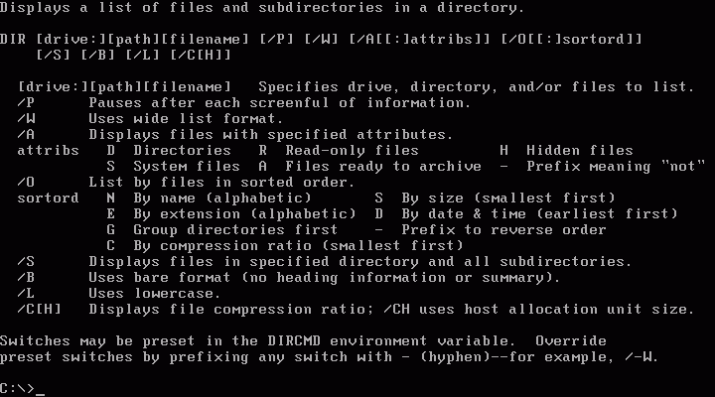
MS DOS

Slide 52
Popular commands of MS DOS
cd- change directory
dir- see the available files and directories in the current directory
copy- copy one or more files to an alternate location.
del- to delete files from the computer
find- to search a string in a given file
help- starts MS-DOS help
move- to move files or directories from one folder to another etc
Notes:
Internal and External DOS commands- http://www.tech-wonders.com/2011/06/most-commonly-used-internal-and.html
Some External Commands
EDIT
CHKDSK
TREE
DELTREE
SORT

Slide 53
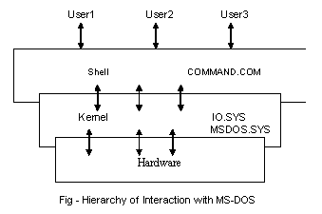
Architecture of DOS

Slide 54
MS Windows Operating System
Developed by Microsoft and supports GUI
Multi-user multi-tasking operating system so the user can run more than one application at a time
Initially developed and introduced by Microsoft in 1985 as GUI for MS DOS OS
Later developed into full fledged OS
Most widely used personal computer OS having more than 90% share

Slide 55
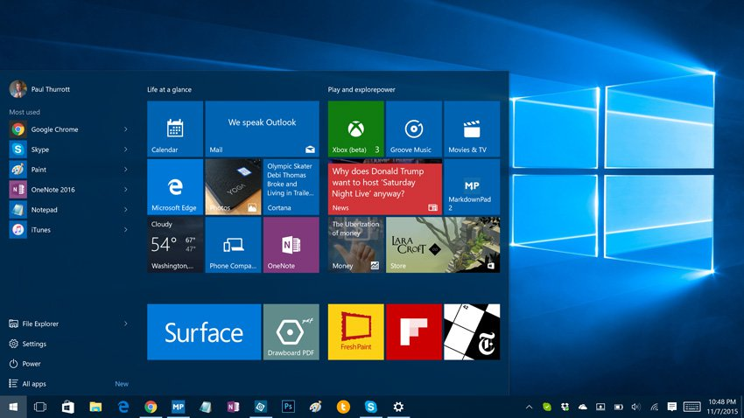
MS Windows OS

Slide 56
Popular versions of MS Windows
Windows 1.x (1985)
Windows 2.x (1987)
Windows 3.x (1990)
Windows 95 (1995)
Windows 98 (1998)
Windows 2000/ME (2000)
Windows XP (2001)
Windows Vista (2007)
Windows 7 (2009)
Windows 8/8.1 (2012)
Windows 10 (2015)

Slide 57
Advantages
Millions of softwares
Support for very large number of devices
Highly stable

Slide 58
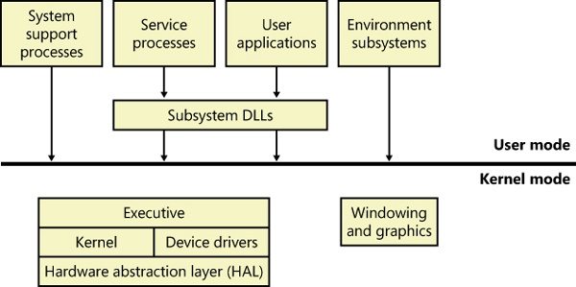
Architecture of Windows OS
Notes:
http://flylib.com/books/en/4.491.1.27/1/
https://books.google.co.in/books?id=xLj0waeFnFQC&pg=PT34&lpg=PT34&dq=windows+%22system+support+processes%22&source=bl&ots=bmM9PfjqNw&sig=uyGjEC0OCTSOVoCg4Ka51KwRYQ8&hl=en&sa=X&ved=0ahUKEwjS1ouBzMvOAhUHLY8KHSmxCm4Q6AEIKjAC#v=onepage&q=windows%20%22system%20support%20processes%22&f=false

Slide 59

Developed in 1970s by Ken Thompson and Dennis Ritchie
Stable multiuser multitasking OS for servers and laptops and desktop computers
Written in C
  First portable OS
Comprises of three parts
  Kernel: it is the hub of OS that performs allocations or resources
  Shell: it acts as the interface between user and the kernel
  File processor: a process is a program under execution and a file is the collection of data

Slide 60

Flexible as it can be easily installed
Stable than Windows and requires less maintenance
Provides more security and processing power is greater than Windows
Used by web servers, supercomputers and smartphones (Android)

Slide 61
LINUX
Powerful open source OS based on UNIX
Available for free download from Internet and can be changed
Used in most smartphones, servers, mainframes, and supercomputers.
Developed and released by Linus Trovalds in October, 1991
Advantages:
Low cost
Stable
High performance
Network capabilities
Flexible
Easy to install
Multi-tasking
Multiuser

Slide 62
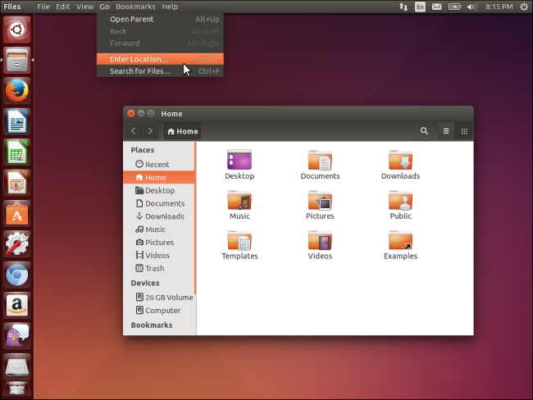
LINUX

Slide 63
Popular commands of Linux
ls --- Lists your files
cp filename1 filename2 --- copies a file
rm filename --- removes a file
mv filename1 filename2 --- moves a file
mkdir dirname --- make a new directory
cd dirname --- change directory
diff filename1 filename2 --- compares files, and shows where they differ
cat filename – to view the contents of existing files
man command_name –to view help on any command

Slide 64
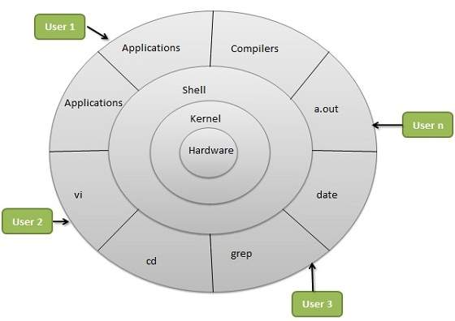
Architecture of Linux

Slide 65
What is Android
Android is an open source operating system, created by Google specifically for use on mobile devices (cell phones and tablets)
Linux based (2.6 kernel)
Can be programmed in C/C++ but most app development is done in Java (Java access to C Libraries via JNI (Java Native Interface))
Supports Bluetooth, Wi-Fi, and 3G and 4G networking
Multitasking single user operating system

Slide 66
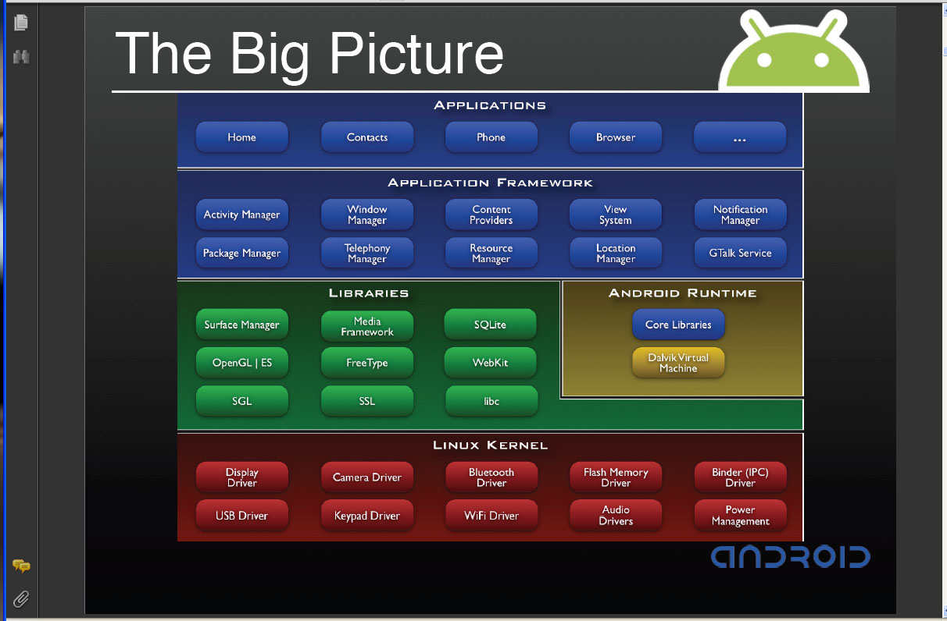
Android Architecture

Slide 67
Versions of Android
Cupcake (Ver 1.5)
Donut (Ver 1.6)
Eclair (Ver 2.0-2.1)
Froyo (Ver 2.2)
Gingerbread (Ver 2.3)
Honeycomb (Ver 3.0-3.2)
Ice Cream Sandwich (Ver 4.0)
Jelly Bean (Ver 4.1-4.3)
Kitkat (Ver 4.4)
Lollipop (Ver 5.0)
Marshmallow (Ver 6.0)
Nougat (Ver 7.0)

Slide 68
Advantages of Android
Open source code
Can be modified as per requirement
Free of cost
Large number of applications

Slide 69
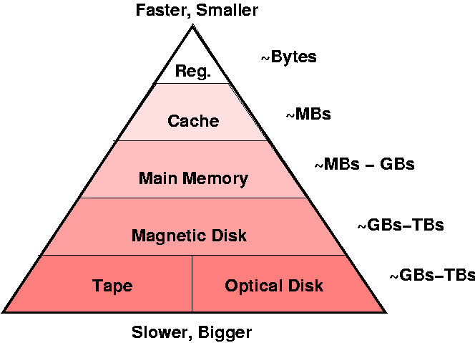
Storage Hierarchy

Slide 70
Algorithm and Flowcharts

Slide 71

Formally defined step by step solution for a given problem
If a procedure is formally defined, then it must be implemented using some programming languages
Mainly used to achieve software re-use
An effective procedure for solving a problem in a finite number of steps

Slide 72
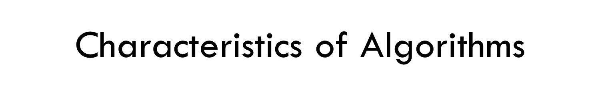
Precision
Clarity
Not even a single instruction must be repeated infinitely
After the algorithm gets terminated, the desired result must be obtained

Slide 73
Control Structures used in Algorithms
Sequence means that each step of the algorithm is executed in the specified order.
Decision statements are used when the execution of a process depends on the outcome of some condition.
Repetition involves executing one or more steps for a number of times. Can be implemented using constructs such as while, do-while, and for loops.

Slide 74
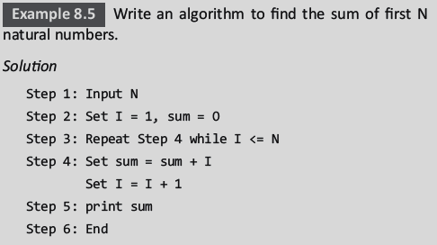
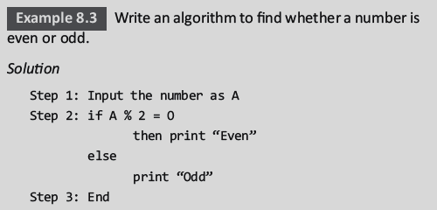
Examples of Algorithms

Slide 75

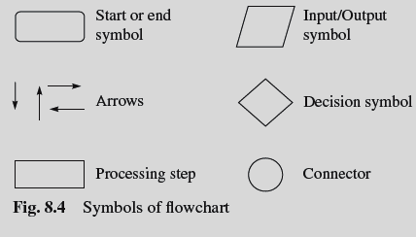
A graphical or symbolic representation of a process
Used to design and document complex processes to help the viewers to visualize the logic of the process
Provides a better understanding of the process and find flaws, bottlenecks, and other less obvious features within it
Usually drawn in the early stages of formulating computer solutions

Slide 76
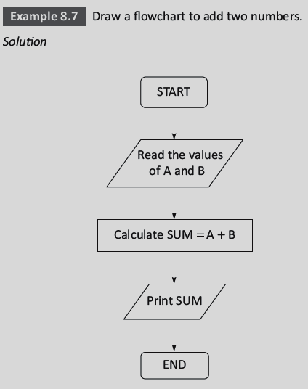
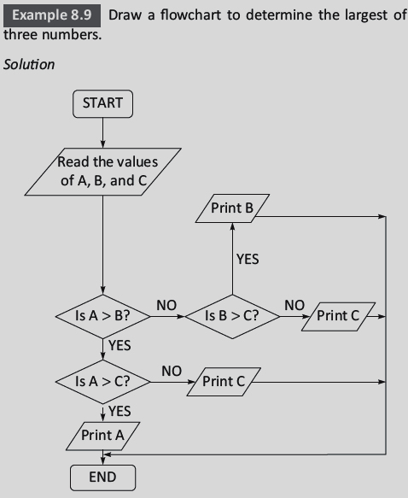
Examples of Flowcharts

Slide 77
Q- Differentiate between algorithm and flowchart [Very Imp]

Slide 78
Approaches to problem solving [Very Imp]
Top Down Approach or step wise refinement
  Start with the initial solution
  Break it in smaller solutions (refine the details)
  Continue previous step untill solution becomes simple enough to be dealt with directly
Bottom Up Approach
  Start with simpler solutions
  Combine them to get the solution of the original problem

